Slide 1

Sequence to Sequence Learning
MLT Deep Learning Workshop
Image: https://google.github.io/seq2seq/

Slide 2
Application areas
RNN/GRU/LSTM
RNN/LSTM Encoder-Decoder
Attention
Beam Search
Evaluation metrics
Good reads and tutorials
Overview: Intro to seq2seq
Image: https://google.github.io/seq2seq/

Slide 3
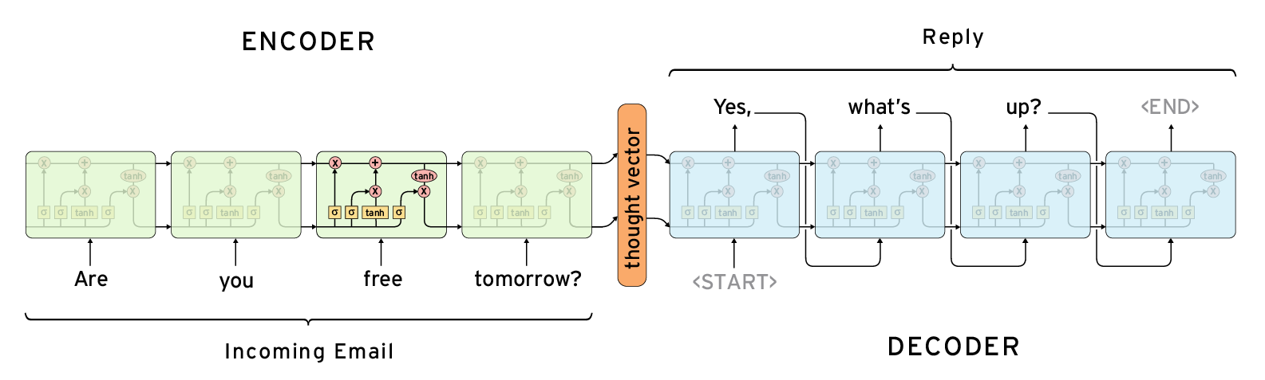
Overview: Intro to seq2seq
Image: http://www.wildml.com/2016/04/deep-learning-for-chatbots-part-1-introduction/

Slide 4
Machine Translation
Dialogue systems (chatbots)
Question Answering
Speech Recognition
Text Summarization (Abstractive Summarization)
Image Captioning
...
Application Areas for Encoder-Decoder Systems
Image: https://thenextweb.com/events/2019/02/11/t500-tnw2019/

Slide 5
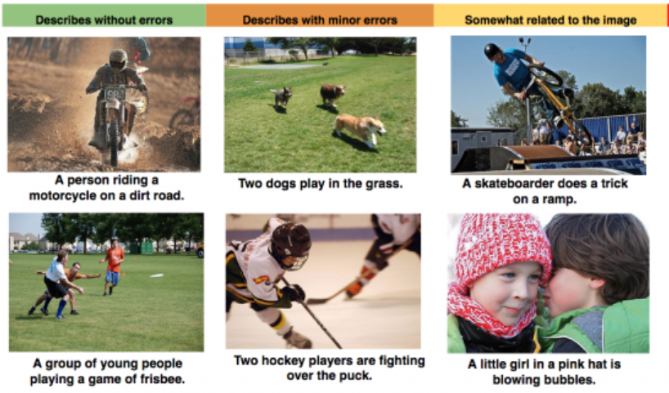
Application Areas for Encoder-Decoder Systems
Image: https://thenextweb.com/events/2019/02/11/t500-tnw2019/

Slide 6
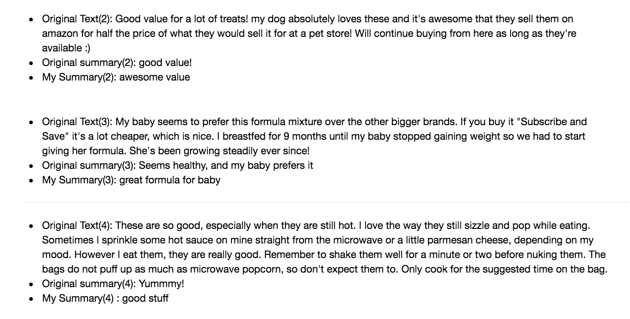
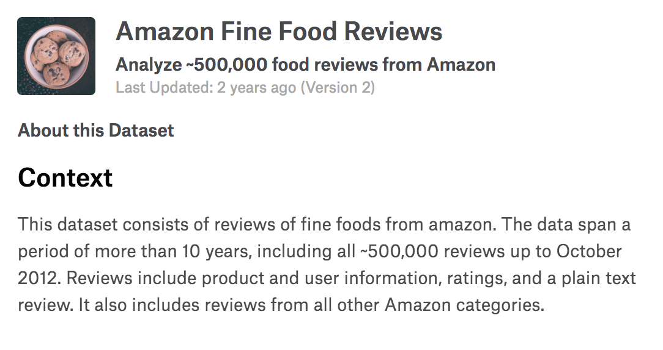
Application Areas for Encoder-Decoder Systems
Text Summarization with Amazon Reviews (500k)
Notebook: https://github.com/theamrzaki/text_summurization_abstractive_methods/blob/master/Implementation%20A%20(seq2seq%20with%20attention%20and%20feature%20rich%20representation)/Model_1.ipynb
Kaggle:
https://www.kaggle.com/currie32/summarizing-text-with-amazon-reviews/data

Slide 7
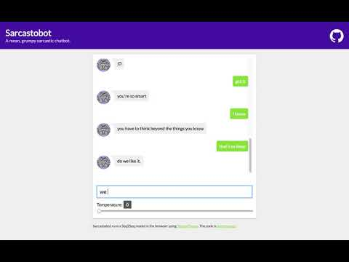
Application Areas for Encoder-Decoder Systems
Video: MLT at NeurIPS 2018 Workshop; Machine Learning for Creativity and Design https://www.youtube.com/watch?v=NEkYrV_YZLk
Try it out
https://machine-learning-tokyo.github.io/seq2seq_bot/

Slide 8
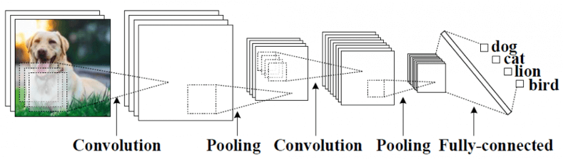
RNN, LSTM, GRU
Vanilla Neural Networks (and also Convolutional Networks) have constraints: they accept a fixed-sized vector as input (e.g. an image) and produce a fixed-sized vector as output (e.g. probabilities of different classes).
http://karpathy.github.io/2015/05/21/rnn-effectiveness/

Slide 9
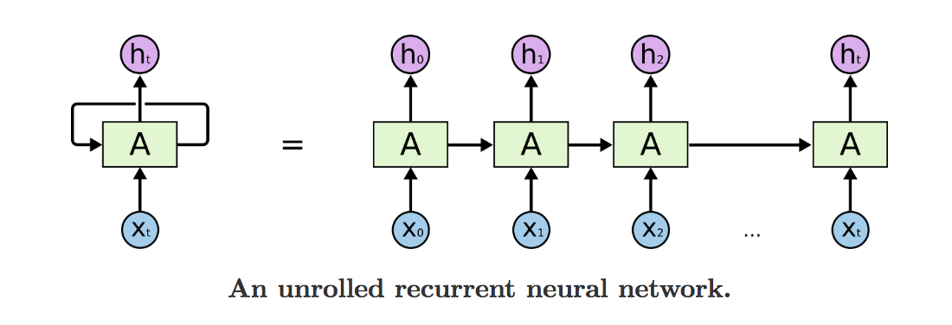
RNN, GRU, LSTM
An RNN processes sequences one element at a time while retaining a memory (called a state) of what has come previously in the sequence. The output at the current time step becomes the input to the next time step. At each element of the sequence, the model considers not just the current input, but what it remembers about the preceding elements.
In the diagram, a chunk of neural network, A, looks at some input x_{t}, and outputs a value h_{t}. A loop allows information to be passed from one step of the network to the next.
https://towardsdatascience.com/recurrent-neural-networks-by-example-in-python-ffd204f99470
https://arxiv.org/pdf/1409.3215.pdf
http://colah.github.io/posts/2015-08-Understanding-LSTMs/

Slide 10
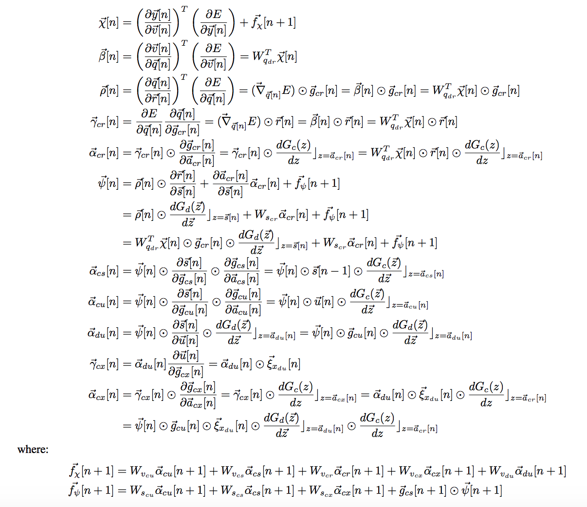
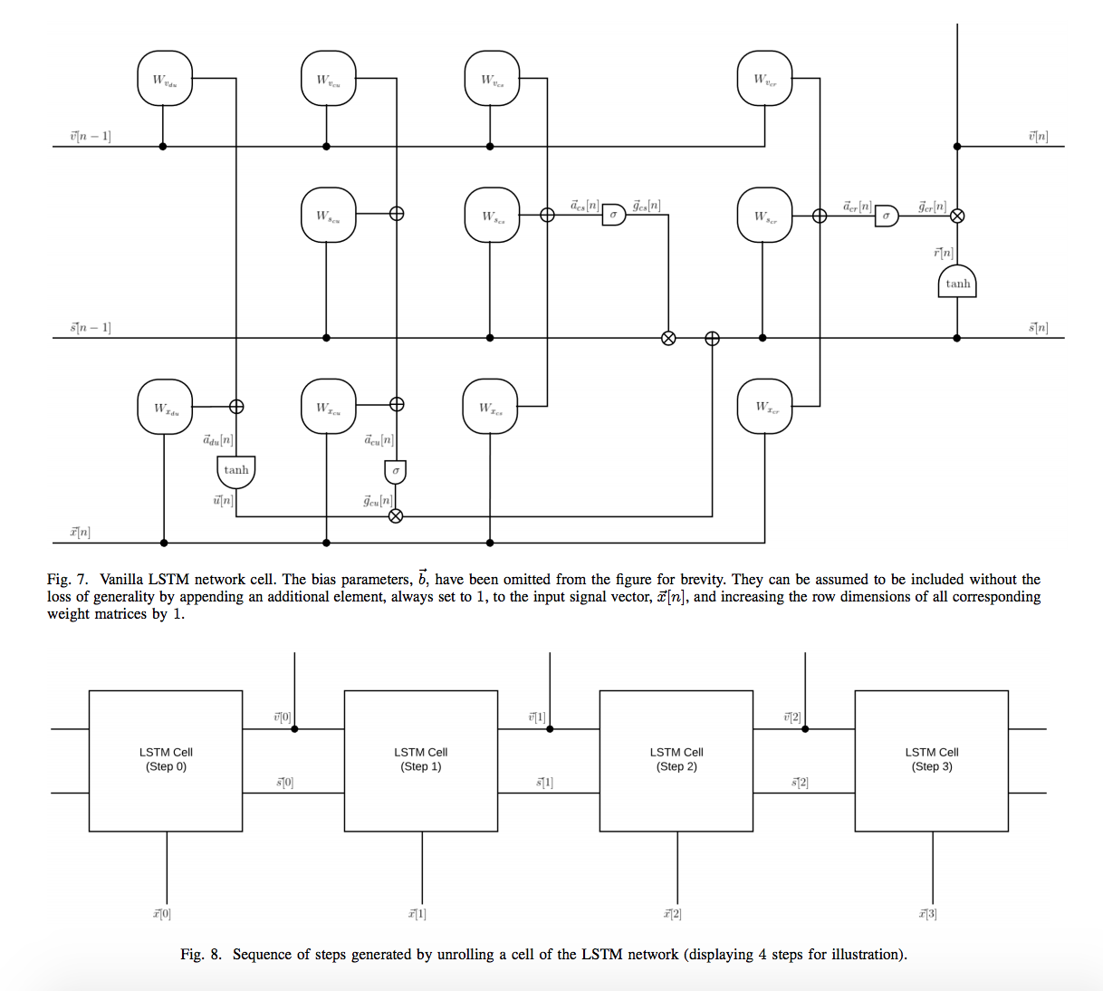
RNN, LSTM, GRU
"Fundamentals of Recurrent Neural Network (RNN) and Long Short-Term Memory (LSTM) Network." https://arxiv.org/abs/1808.03314

Slide 11
RNN, LSTM, GRU
Top-down:
“In summary, you don’t need to understand everything about the specific architecture of an LSTM cell; as a human, it shouldn’t be your job to understand it. Just keep in mind what the LSTM cell is meant to do:
allow past information to be reinjected at a later time.”
Francois Chollet, Deep Learning with Python

Slide 12
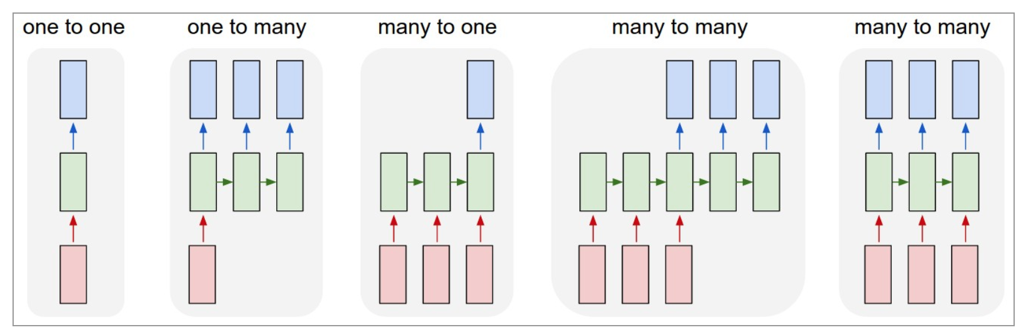
RNN, LSTM, GRU
Image: http://karpathy.github.io/2015/05/21/rnn-effectiveness/

Slide 13
RNN, LSTM, GRU
From left to right:
(1) Vanilla mode of processing without RNN, from fixed-sized input to fixed-sized output (e.g. image classification).
(2) Sequence output (e.g. image captioning takes an image and outputs a sentence of words).
(3) Sequence input (e.g. sentiment analysis where a given sentence is classified as expressing positive or negative sentiment).
(4) Sequence input and sequence output (e.g. Machine Translation: an RNN reads a sentence in English and then outputs a sentence in French).
(5) Synced sequence input and output (e.g. video classification where we wish to label each frame of the video).
Source: http://karpathy.github.io/2015/05/21/rnn-effectiveness/

Slide 14
Sequence to Sequence Learning
Sequence to Sequence Learning with Neural Networks
Ilya Sutskever, Oriol Vinyals, Quoc V. Le
Introduces seq2seq (2014) with LSTMs
“Our method uses a multilayered Long Short-Term Memory (LSTM) to map the input sequence to a vector of a fixed dimensionality, and then another deep LSTM to decode the target sequence from the vector.”
LSTMs capture long range temporal dependencies.
Machine Translation Task
Paper: https://arxiv.org/pdf/1409.3215.pdf
Another important paper, prior to the one above: Learning Phrase Representations using RNN Encoder-Decoder for Statistical Machine Translation
https://arxiv.org/abs/1406.1078

Slide 15
Sequence to Sequence Learning
Image: http://www.wildml.com/2016/04/deep-learning-for-chatbots-part-1-introduction/

Slide 16
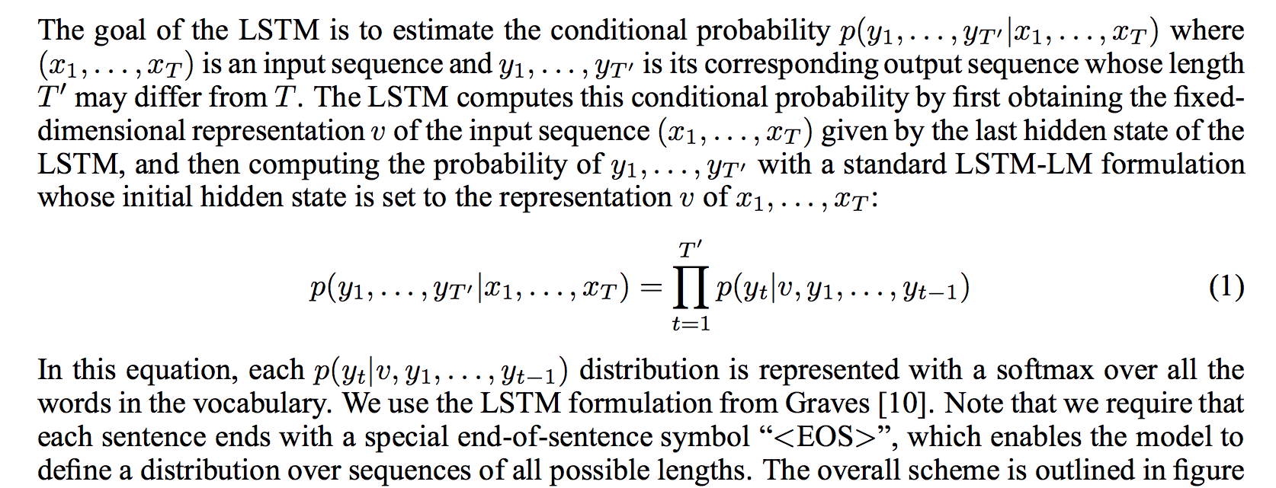
Sequence to Sequence Learning
Paper: https://arxiv.org/pdf/1409.3215.pdf

Slide 17
Attention
The state vector, the last hidden state of the encoder, must encode everything we need to know about the source sentence. In more technical terms, that vector is a sentence embedding.
With an attention mechanism we no longer try encode the full source sentence into a fixed-length vector. The decoder focuses on different parts of the source sentence at each step of the output generation. Each decoder output word now depends on a weighted combination of all the input states, not just the last state. The weights are typically normalized to sum to 1 (a a distribution over the input states).
Source: http://www.wildml.com/2016/01/attention-and-memory-in-deep-learning-and-nlp/

Slide 18
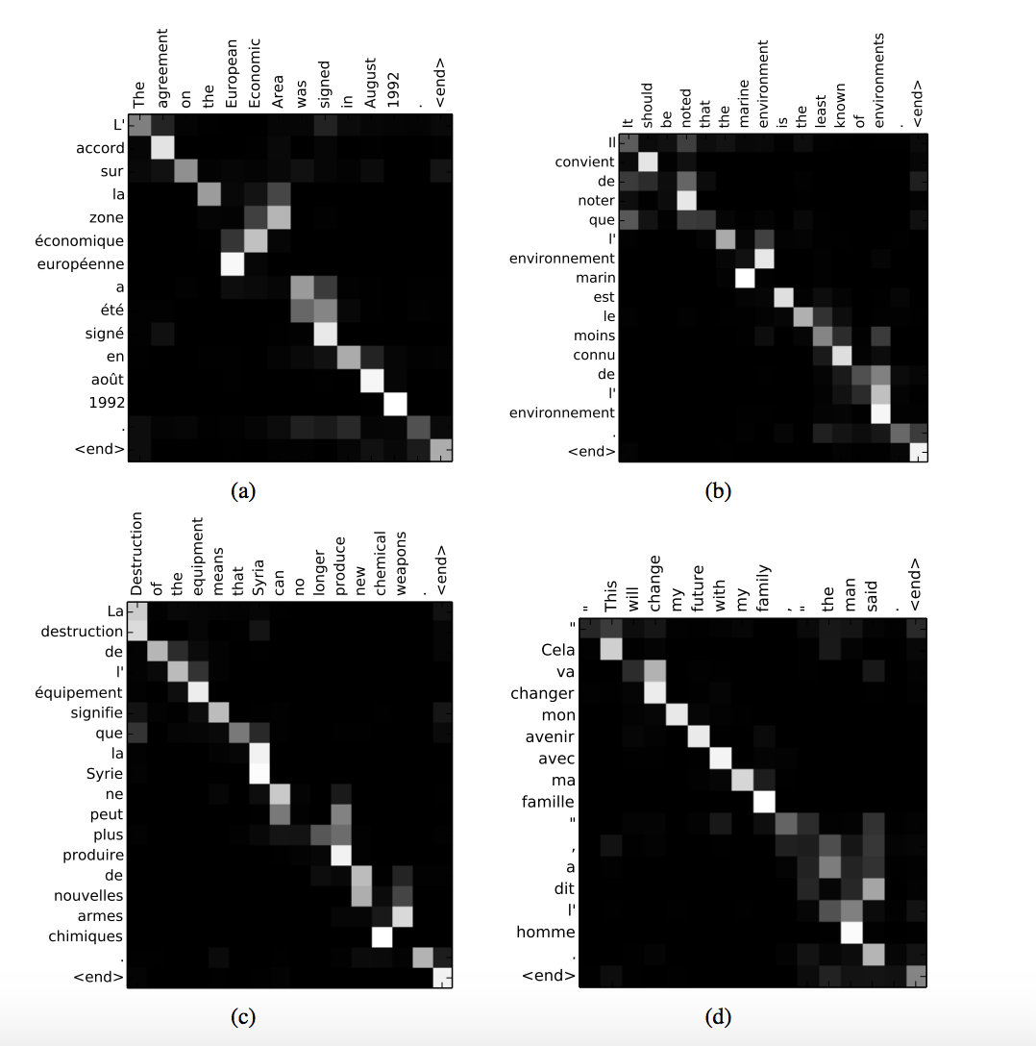
Attention
One benefit of attention that we’re able to visualize and interpret what the model is doing. For example, by visualizing the attention weight matrix when a sentence is translated, we can understand how the model is translating.
Source: http://www.wildml.com/2016/01/attention-and-memory-in-deep-learning-and-nlp/

Slide 19
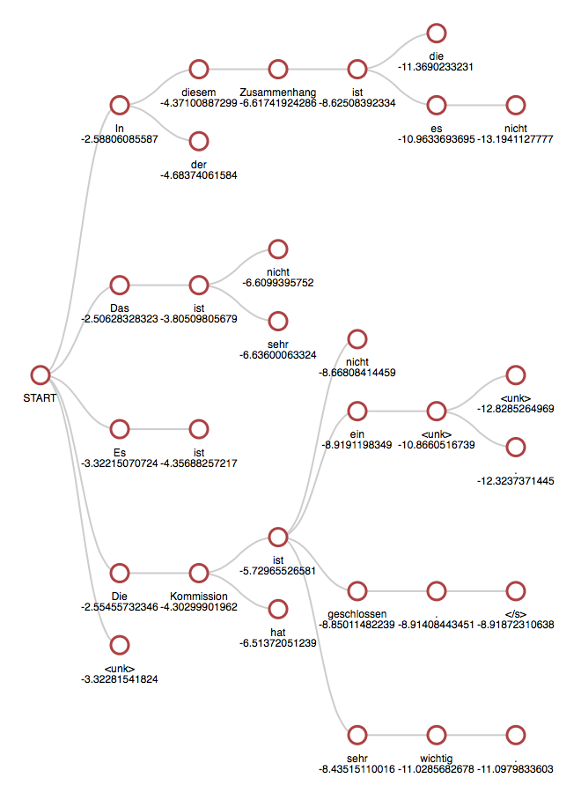
Beam Search
Greedy Search will pick the most likely token and move on.
Beam Search considers multiple alternatives at each time step, e.g.
B = 5 (beam width)

Slide 20
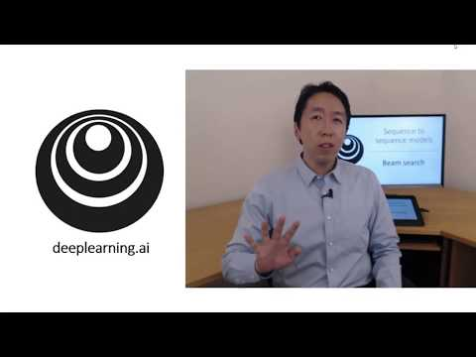
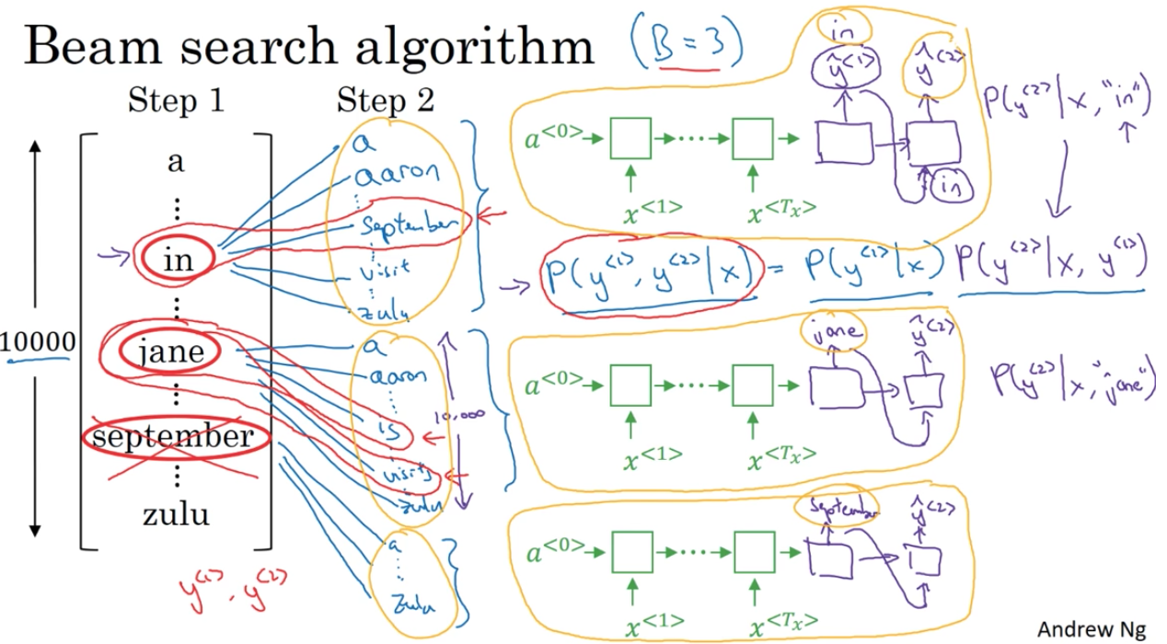
Beam Search
Andrew Ng https://www.youtube.com/watch?v=RLWuzLLSIgw
Further reads: https://arxiv.org/abs/1606.02960

Slide 21
Evaluation
Computational metrics
BLEU Bleu measures precision: how many n-grams in the machine generated text appeared in the human reference text.
ROUGE Rouge measures recall: how many n-grams in the human reference text appeared in the machine generated text.
METEOR Harmonic mean of n-gram precision and recall
Perplexity measures of how well a probability distribution or probability model predicts a sample.
Human Evaluation
Word overlap metrics are not suitable for Dialogue Systems
A: What are you up to? Ground truth: Not much.
A: What are you up to? Prediction: I’m answering emails.

Slide 22
Workshop Evaluation
Please share your feedback: https://goo.gl/forms/9IgFhQqcJPXVGJzg2

Slide 23
Good reads and tutorials
Good reads
The Unreasonable Effectiveness of Recurrent Neural Networks http://karpathy.github.io/2015/05/21/rnn-effectiveness/
Understanding LSTMs
http://colah.github.io/posts/2015-08-Understanding-LSTMs/
Practical seq2seq http://complx.me/2016-12-31-practical-seq2seq/
Denny Britz: Attention and Memory in Deep Learning and NLP http://www.wildml.com/2016/01/attention-and-memory-in-deep-learning-and-nlp/
Attention Mechanisms
https://blog.heuritech.com/2016/01/20/attention-mechanism/

Slide 24
Good reads and tutorials
Papers
Sequence to Sequence Learning with Neural Networks (Sutskever et al., 2014) https://arxiv.org/pdf/1409.3215.pdf
Learning Phrase Representations using RNN Encoder-Decoder for Statistical Machine Translation (Cho et al., 2014) https://arxiv.org/abs/1406.1078
Generating Sequences With Recurrent Neural Networks (Graves, 2014) https://arxiv.org/pdf/1308.0850.pdf
Sequence-to-Sequence Learning as Beam-Search Optimization (Wiseman et al., 2016) https://arxiv.org/abs/1606.02960

Slide 25
Good reads and tutorials
Tutorials and repos
A ten-minute introduction to sequence-to-sequence learning in Keras (Machine Translation) https://blog.keras.io/a-ten-minute-introduction-to-sequence-to-sequence-learning-in-keras.html
Seq2seq chatbot https://github.com/Machine-Learning-Tokyo/seq2seq_bot
Abstractive Text Summarization with seq2seq (TensorFlow) https://github.com/theamrzaki/text_summurization_abstractive_methods/tree/master/Implementation%20A%20(seq2seq%20with%20attention%20and%20feature%20rich%20representation)
Video lectures
Sequence Models by Andrew Ng
https://www.coursera.org/learn/nlp-sequence-models
Quoc Le Sequence to Sequence Deep Learning
https://www.youtube.com/watch?v=G5RY_SUJih4&t=1746s

Slide 26
Find MLT on
Meetup
https://meetup.com/Machine-Learning-Tokyo/
GitHub
https://github.com/Machine-Learning-Tokyo
Youtube https://youtube.com/MLTOKYO
Slack
https://goo.gl/WnbYUP

